Slide 1
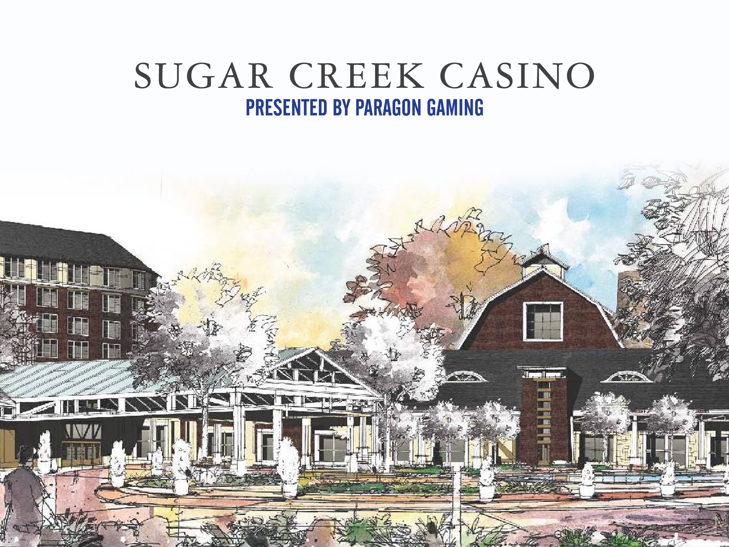


Slide 2
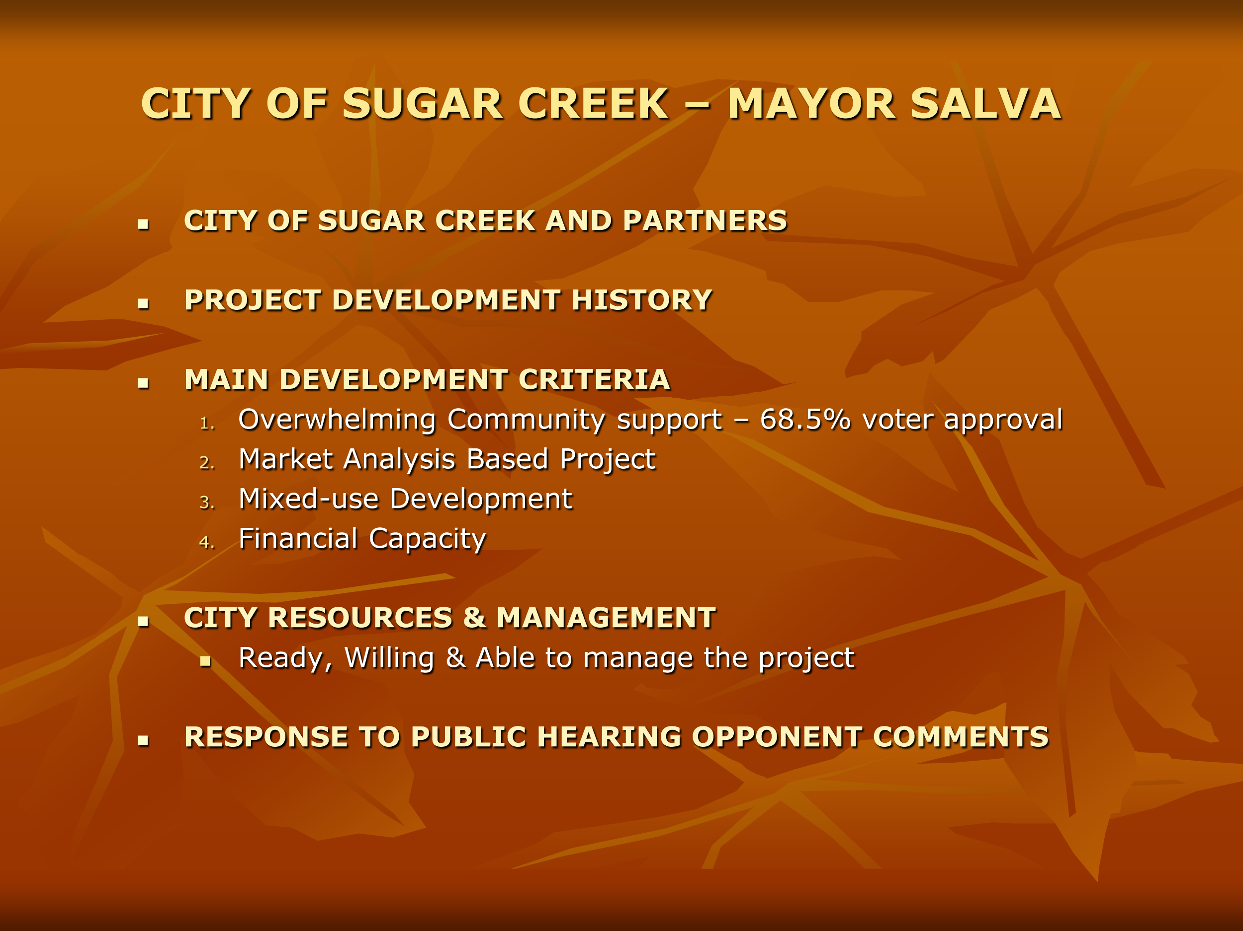

Slide 3
VIDEO

Slide 4
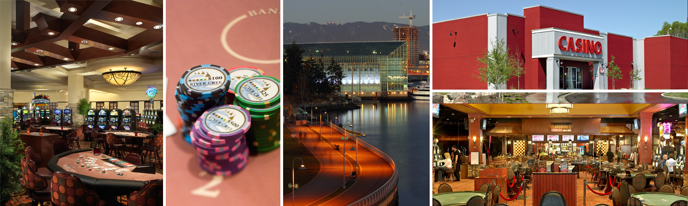
DIANA L. BENNETT - CEO
Paragon Background
Long-standing history in Las Vegas community & gaming industry
Paragon currently owns and operates:
Edgewater Casino in Vancouver, British Columbia
Eagle River Casino and Travel Plaza in Whitecourt, Alberta
River Cree Resort and Casino in Edmonton, Alberta

Slide 5

PARTNERSHIP WITH EPIC/GAUGHAN
Paragon/Epic/Gaughan Joint Venture
  Paragon Gaming – Majority Partner
  JV to develop and operate the Sugar Creek Casino
  Long-standing relationship between Las Vegas families & companies
  Executives responsible for successful development & operation of landmark projects
Epic/Gaughan
  Provided Notice of Interest in Sugar Creek Project
  Epic principals have extensive expertise in multiple gaming jurisdictions
  Gaughan is a multi-generation casino operator in Las Vegas, Nevada

Slide 6
Paragon Approach: Gaming evolved & so did we…
SCOTT MENKE - PRESIDENT
Paragon approaches each unique project with a Multi-Phased approach

Slide 7
OUR CULTURE – BELIEF IN LASTING RELATIONSHIPS
  The gaming industry today is a Multiple Stakeholder Environment
  We believe the key to success is through strong relationships:
        Local Communities
        State and Provincial Governments
        First Nations Groups
        Regulatory Bodies

Slide 8
PARAGON TEAM – DIVERSE BACKGROUNDS
INDIVIDUAL | POSITION | EXPERIENCE
Diana Bennett | CEO, Paragon Gaming | 30+ years
Scott Menke | President, Paragon Gaming | 23+ years
John Groom | Chief Operating Officer, Paragon Gaming | 30+ years
John Cahill | Corporate Secretary, Paragon Gaming | 30+ years
Justin Kolb | Corporate Treasurer, Paragon Gaming | 10+ years
Dennis Amerine | Vice President of Compliance, Paragon Gaming | 30+ years
Brent Fleming | Vice President of Human Resources, Organizational Development | 20 years
Clay Crawford | Corporate Director of Finance, Paragon Gaming | 20+ years
Cheryl Price | Corporate Director of Marketing, Paragon Gaming | 10 years
Jennifer Bell-Fields | Regional Operations and Player Development Director, Paragon Gaming | 10+ years
Vik Mahajan | Director of Corporate Operations, Paragon Gaming | 15+ years
Kevan Schell | Vice President and General Manager, River Cree Resort and Casino | 10+ years
Eris Moncur | Vice President and General Manager, Eagle River Casino and Travel Plaza | 10 years
Farzad Amedi | Corporate Director of Surveillance, Paragon Gaming | 10+ years
Mark Holik | Corporate Director of Security and Safety, Paragon Gaming | 20+ Years
Matt Knipp | Director of Development, Paragon Gaming | 7+ Years

Slide 9
JOHN GROOM - COO
Kansas City Market Opportunity
  Eastern Jackson County underserved
  Sugar Creek project centers the gaming market concentration in MO
New Development induces gaming demand
  Sugar Creek generates new market demand
  New competition enhances customer experience at all properties
New Product enhances consumer opportunities
  Cutting edge gaming technology – Server based gaming
  Broader market reach

Slide 10
PROJECT OVERVIEW – PHASE ONE
CASINO
  55,200 sq. ft. single-level, gaming floor housing
  1,200 slot machines
  30 table games, 10 table poker room
FOOD & BEVERAGE
  200 seat buffet, 90 seat café & stand-alone food court
  75 seat sports bar & 50 seat themed bar
  125 seat cabaret/lounge
OTHER
  2,100 sq. ft. of retail
  1,000 vehicle paved parking area

Slide 11
PHASE TWO – DESTINATION CONCEPT
CASINO
    Up to 2,400 slot machines
    Up to 58 table games (including poker)
ENTERTAINMENT
    1,200 seat showroom
    Multi-screen theatre
    6,500 seat arena
FOOD & BEVERAGE
    Additional restaurant concepts
HOTEL
    400 room resort hotel & spa

Slide 12

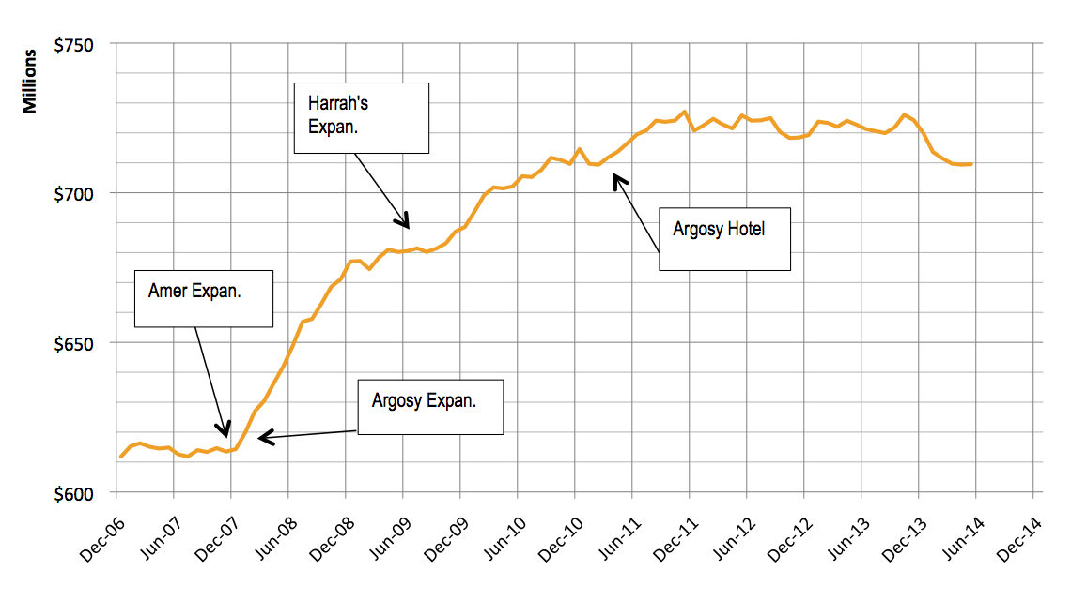
HISTORICAL KANSAS CITY MARKET PERFORMANCE

Slide 13

Enhance the Convenience of Gaming
Additional Alternative with Unique Design/Theme
Additional Alternative with Unique Gaming Product
Increase in Level of Marketing in the Market
Additional Capacity During Peak Times
Additional Traffic Intercept Point
Notes:
13

Slide 14

Notes:
14

Slide 15

 | Gaming Rev | % of Total
Incremental Local Market | $30,446,339 | 31.3%
Incremental Tourism | $1,064,092 | 1.1%
Incremental Traffic Intercept | $3,046,035 | 3.1%
Total Market Growth | $34,556,466 | 35.5%
Recapture from Kansas Properties | $12,235,370 | 12.6%
Incremental to Missouri | $46,791,836 | 48.0%
Capture from Missouri Properties | $50,596,898 | 52.0%
Sugar Creek Gaming Revenue | $97,388,734 | 100.0%
Source: The Innovation Group
Notes:
15

Slide 16

IOC KC | $5,116,846
Argosy | $9,126,425
Ameristar | $22,818,542
Harrah's | $12,199,657
All Other | $1,335,428
Total | $50,596,898
Source: The Innovation Group
Notes:
16

Slide 17

Incremental Gaming Revenue Impact to Missouri (2015)
 | Total | Incremental % | Incremental $
Gaming Tax | $21,738,553 | 48.0% | $10,444,605
Admission Fee | $5,415,517 | 36.2% | $1,962,660
Total | $27,154,070 | 45.7% | $12,407,265
* Includes capture from KS properties.
Source: The Innovation Group
Notes:
17

Slide 18

Construction | Local | State
Output | $105,640,723 | $111,971,161
Labor Income | $35,549,385 | $36,377,203
Employment | 657.7 | 713.1
Operations | Local | State
Output | $56,538,906 | $64,839,464
Labor Income | $30,540,576 | $32,638,292
Employment | 744.1 | 829.4
Source: 2010 Minnesota IMPLAN Group, Inc
Total development cost $115mm, with $71mm directly related to construction. Increases spending by $105.6mm locally and $112mm for the state
Project generates $56.5mm in additional annual spending and
$64.8 mm for the state
$30mm in property, sales, and gaming taxes generated
Notes:
18

Slide 19
DENNIS AMERINE
VICE PRESIDENT OF COMPLIANCE
Experience across multiple jurisdictions
  Former member of Nevada State Gaming Control Board
  Consulted to domestic and international gaming jurisdictions on gaming regulation
  Former Asst. Director of Gaming Regulation Center, UNLV Intl. Gaming Institute
Paragon’s approach to compliance
  Internal Reporting and Compliance System
  Property-level Compliance Officers
  Culture of Self-Reporting
Regulatory relationships in existing jurisdictions
  Alberta Gaming and Liquor Commission
  British Columbia Gaming Policy and Enforcement Branch, Solicitor General
  Nevada State Gaming Control Board

Slide 20
DESIGN & CONSTRUCTION OVERVIEW
ED VANCE ARCHITECTS
Design
  January - June 2011
  Frank Lloyd Wright inspired “Prairie Style”
  Construction Project
    Initial Phase - $71mm; Future Phase - $300mm
    Construction validation by local GC (JE Dunn) & 3rd party (Foxcor)
July 2011 Ground-breaking; 4Q 2012 Opening
  Accelerated schedule could allow for 3Q opening
  Construction Partnership
  713 full-time MO construction jobs
  Commitment to minority participation

Slide 21
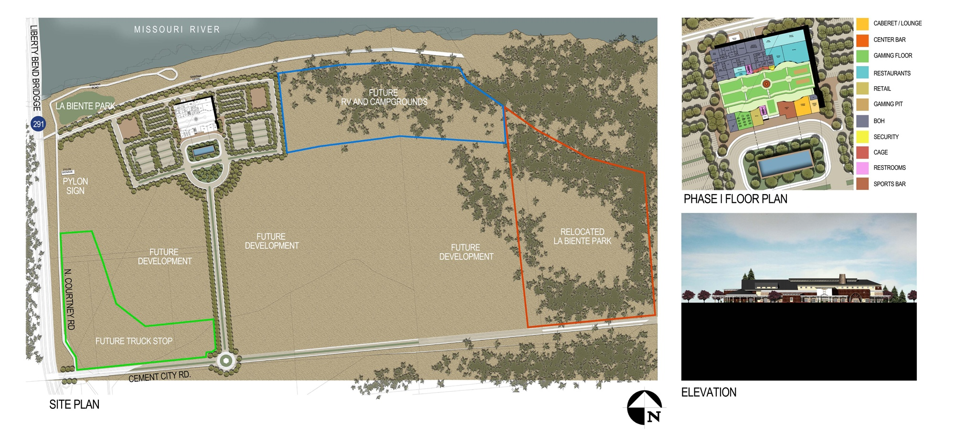
PHASE ONE LAYOUT

Slide 22
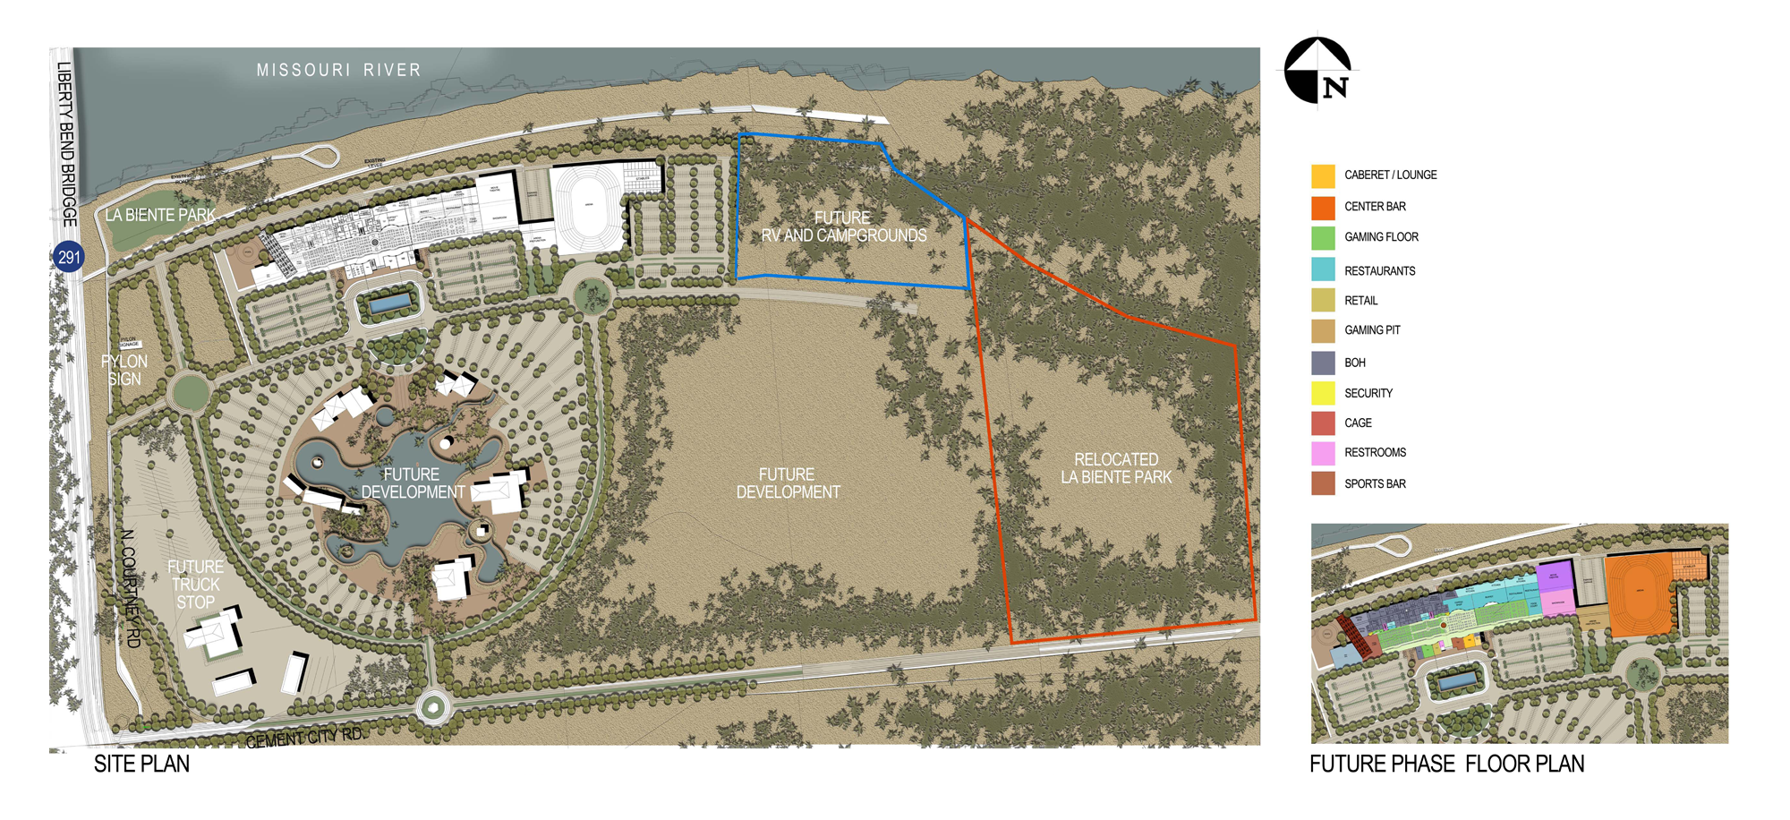
DESTINATION CONCEPT LAYOUT

Slide 23
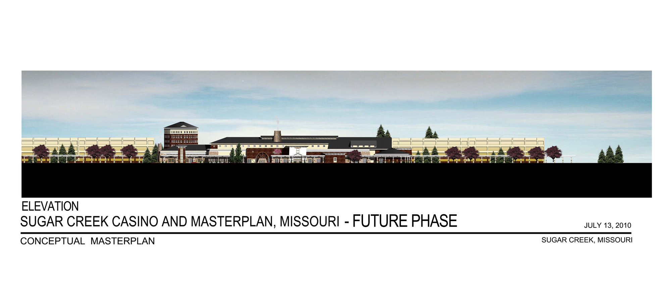
DESTINATION CONCEPT RENDERING
Notes:
23

Slide 24
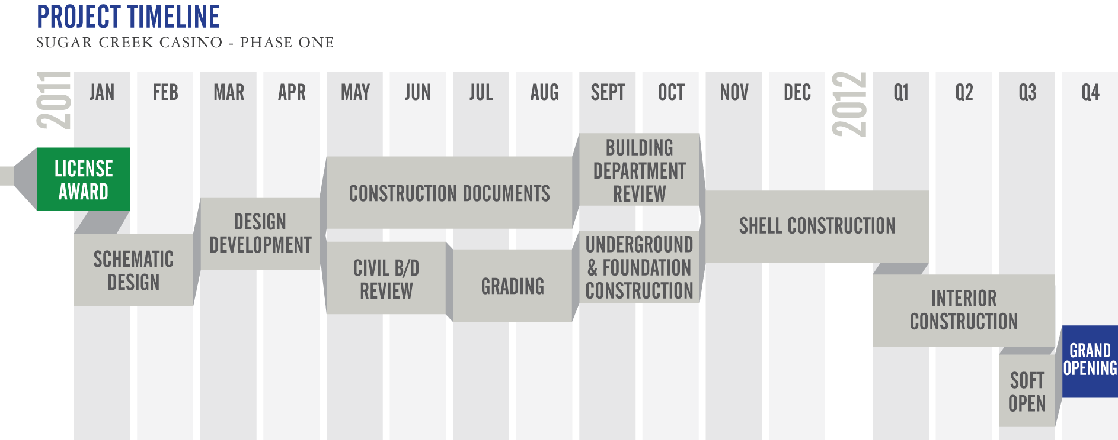
DESIGN & CONSTRUCTION SCHEDULE
ED VANCE ARCHITECTS

Slide 25
SUGAR CREEK PROJECT FINANCING
REGAL CAPITAL ADVISORS
Paragon Gaming - Experienced Capital Providers
  Privately held company
  Capital resources from committed principals
Paragon Gaming – Experienced Capital Markets Partner
  Financed over $300mm of North American projects
Paragon Gaming & Principals – Experienced Developers
  Principals responsible for over $1 Billion of previous development
  $450mm currently under development

Slide 26
SUGAR CREEK PROJECT FINANCING
REGAL CAPITAL ADVISORS
Highly Confident Letter & Indicative Financing Terms
  Obtained from REGAL Capital Advisors
Capital Structure - Initial phase
  $107mm Project Cost plus $8mm of pre-funded interest reserve
  $40mm Project Equity provided by Paragon Gaming and its principals
  $75mm Debt Financing to be arranged by REGAL Capital Advisors
  Option – Up to $20mm Equipment Financing provided by IGT Capital

Slide 27
SUGAR CREEK PROJECT FINANCING
REGAL CAPITAL ADVISORS
Company Overview
Founded by David Berman, CEO, in 2009, to advise Real Estate, Gaming and Lodging companies
Advises public & private companies (Commercial, Native American and First Nations)
Former Managing Director and Head of the Gaming, Lodging & Leisure investment banking group at Credit Suisse
Prior to CS, he was Managing Director and Head of the Gaming, Lodging & Leisure investment banking group at CIBC World Markets and, before its acquisition by CIBC, Head of the Gaming, Lodging & Leisure investment banking group at Oppenheimer & Co.

Slide 28
DIANA L. BENNETT
Paragon believes this Project will be successful…
Right Opportunity
Right Product
Right Team
Right Market
Right Community

Slide 29
EXHIBITS

Slide 30
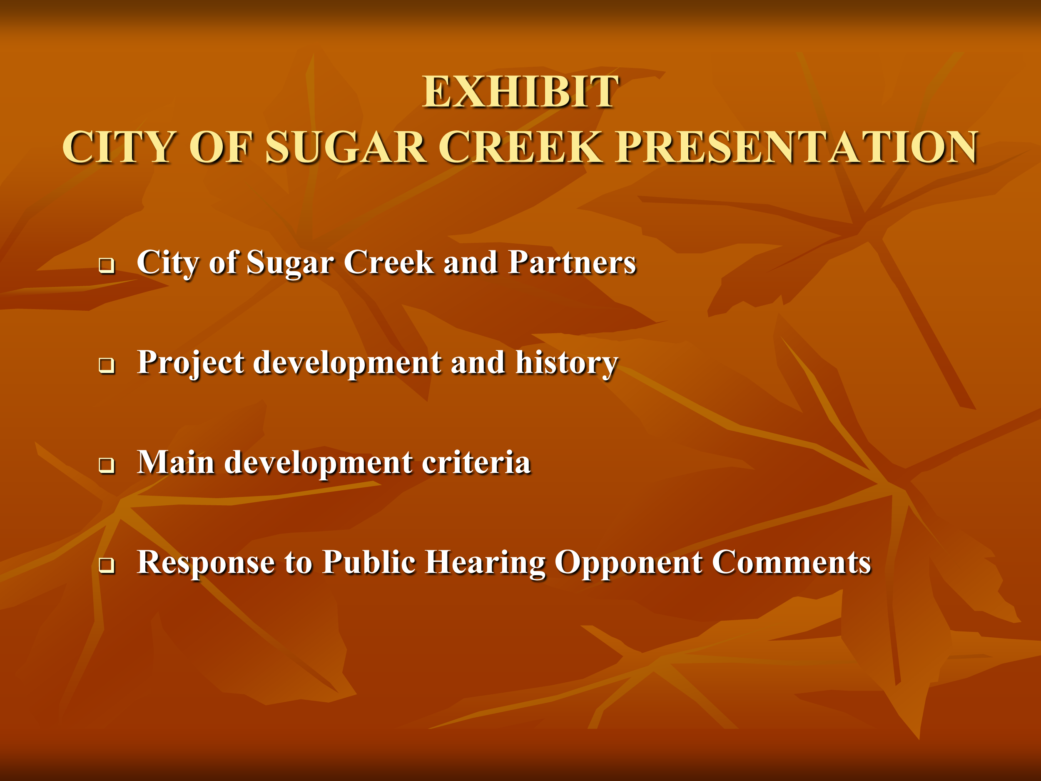

Slide 31


Slide 32
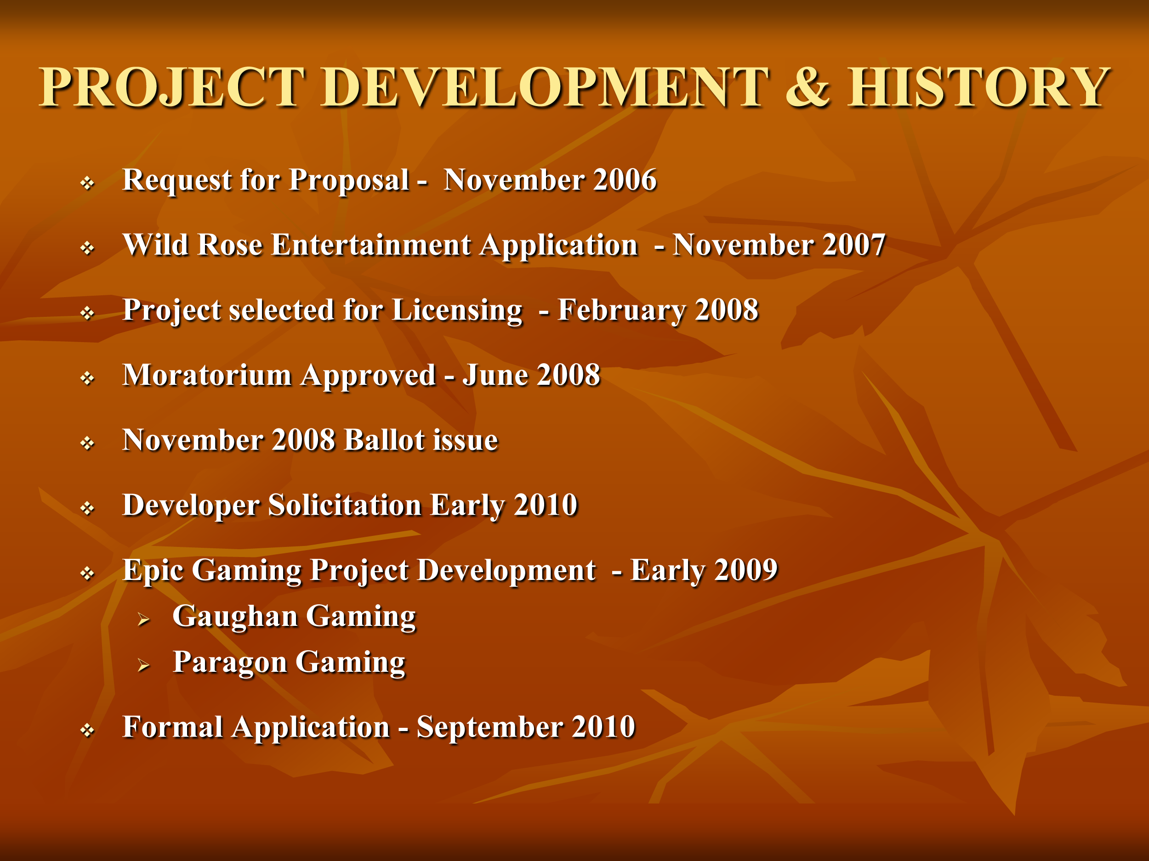

Slide 33
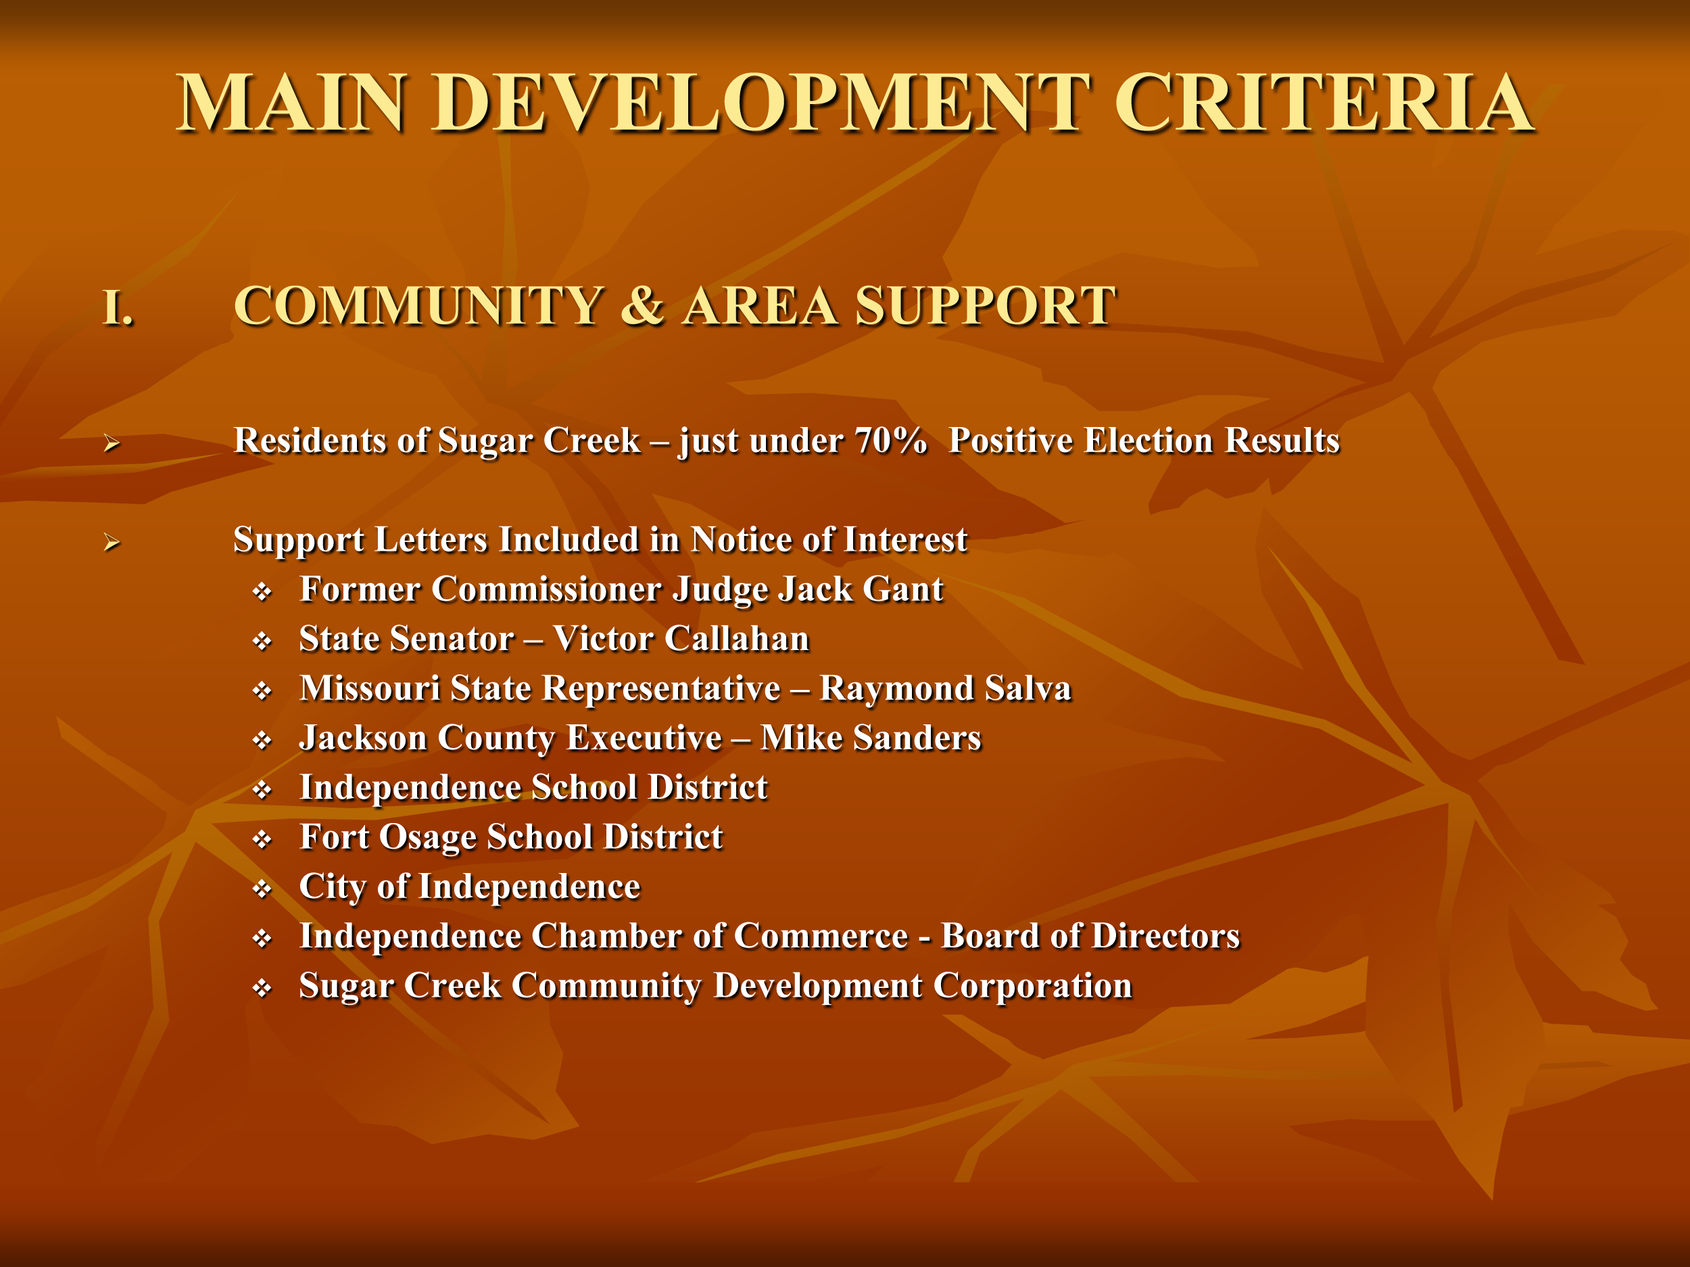

Slide 34
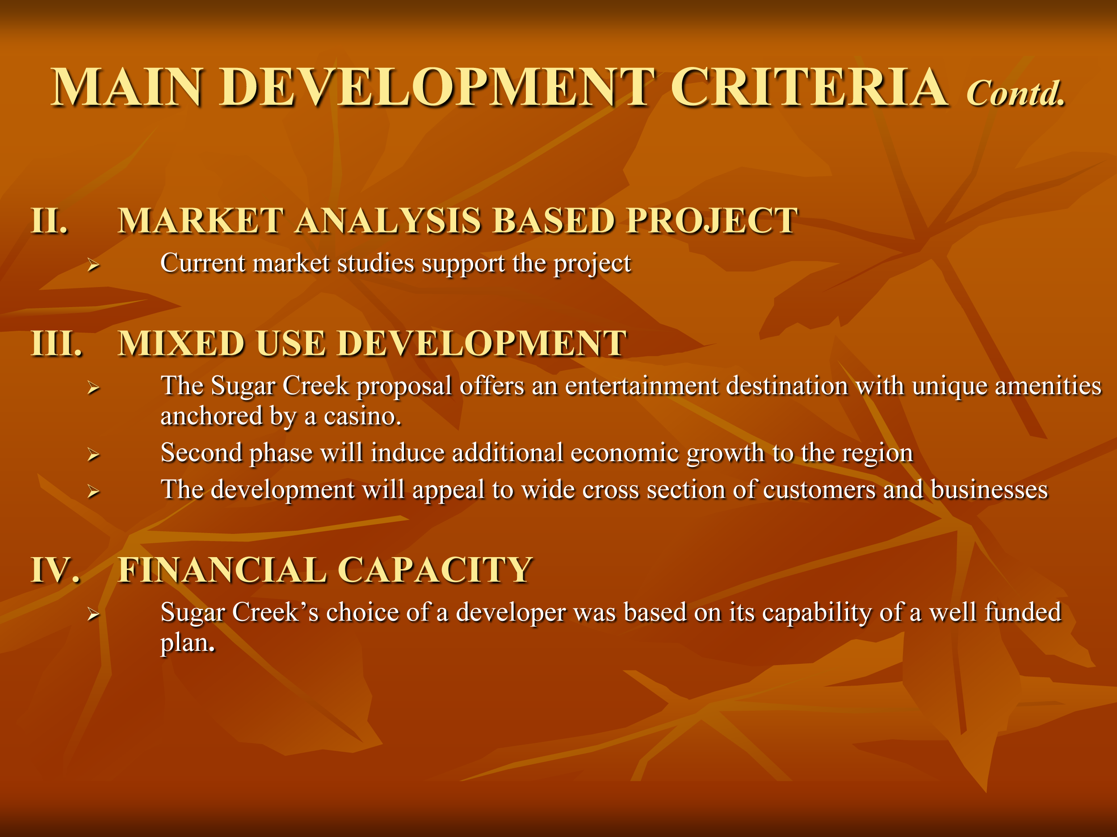

Slide 35
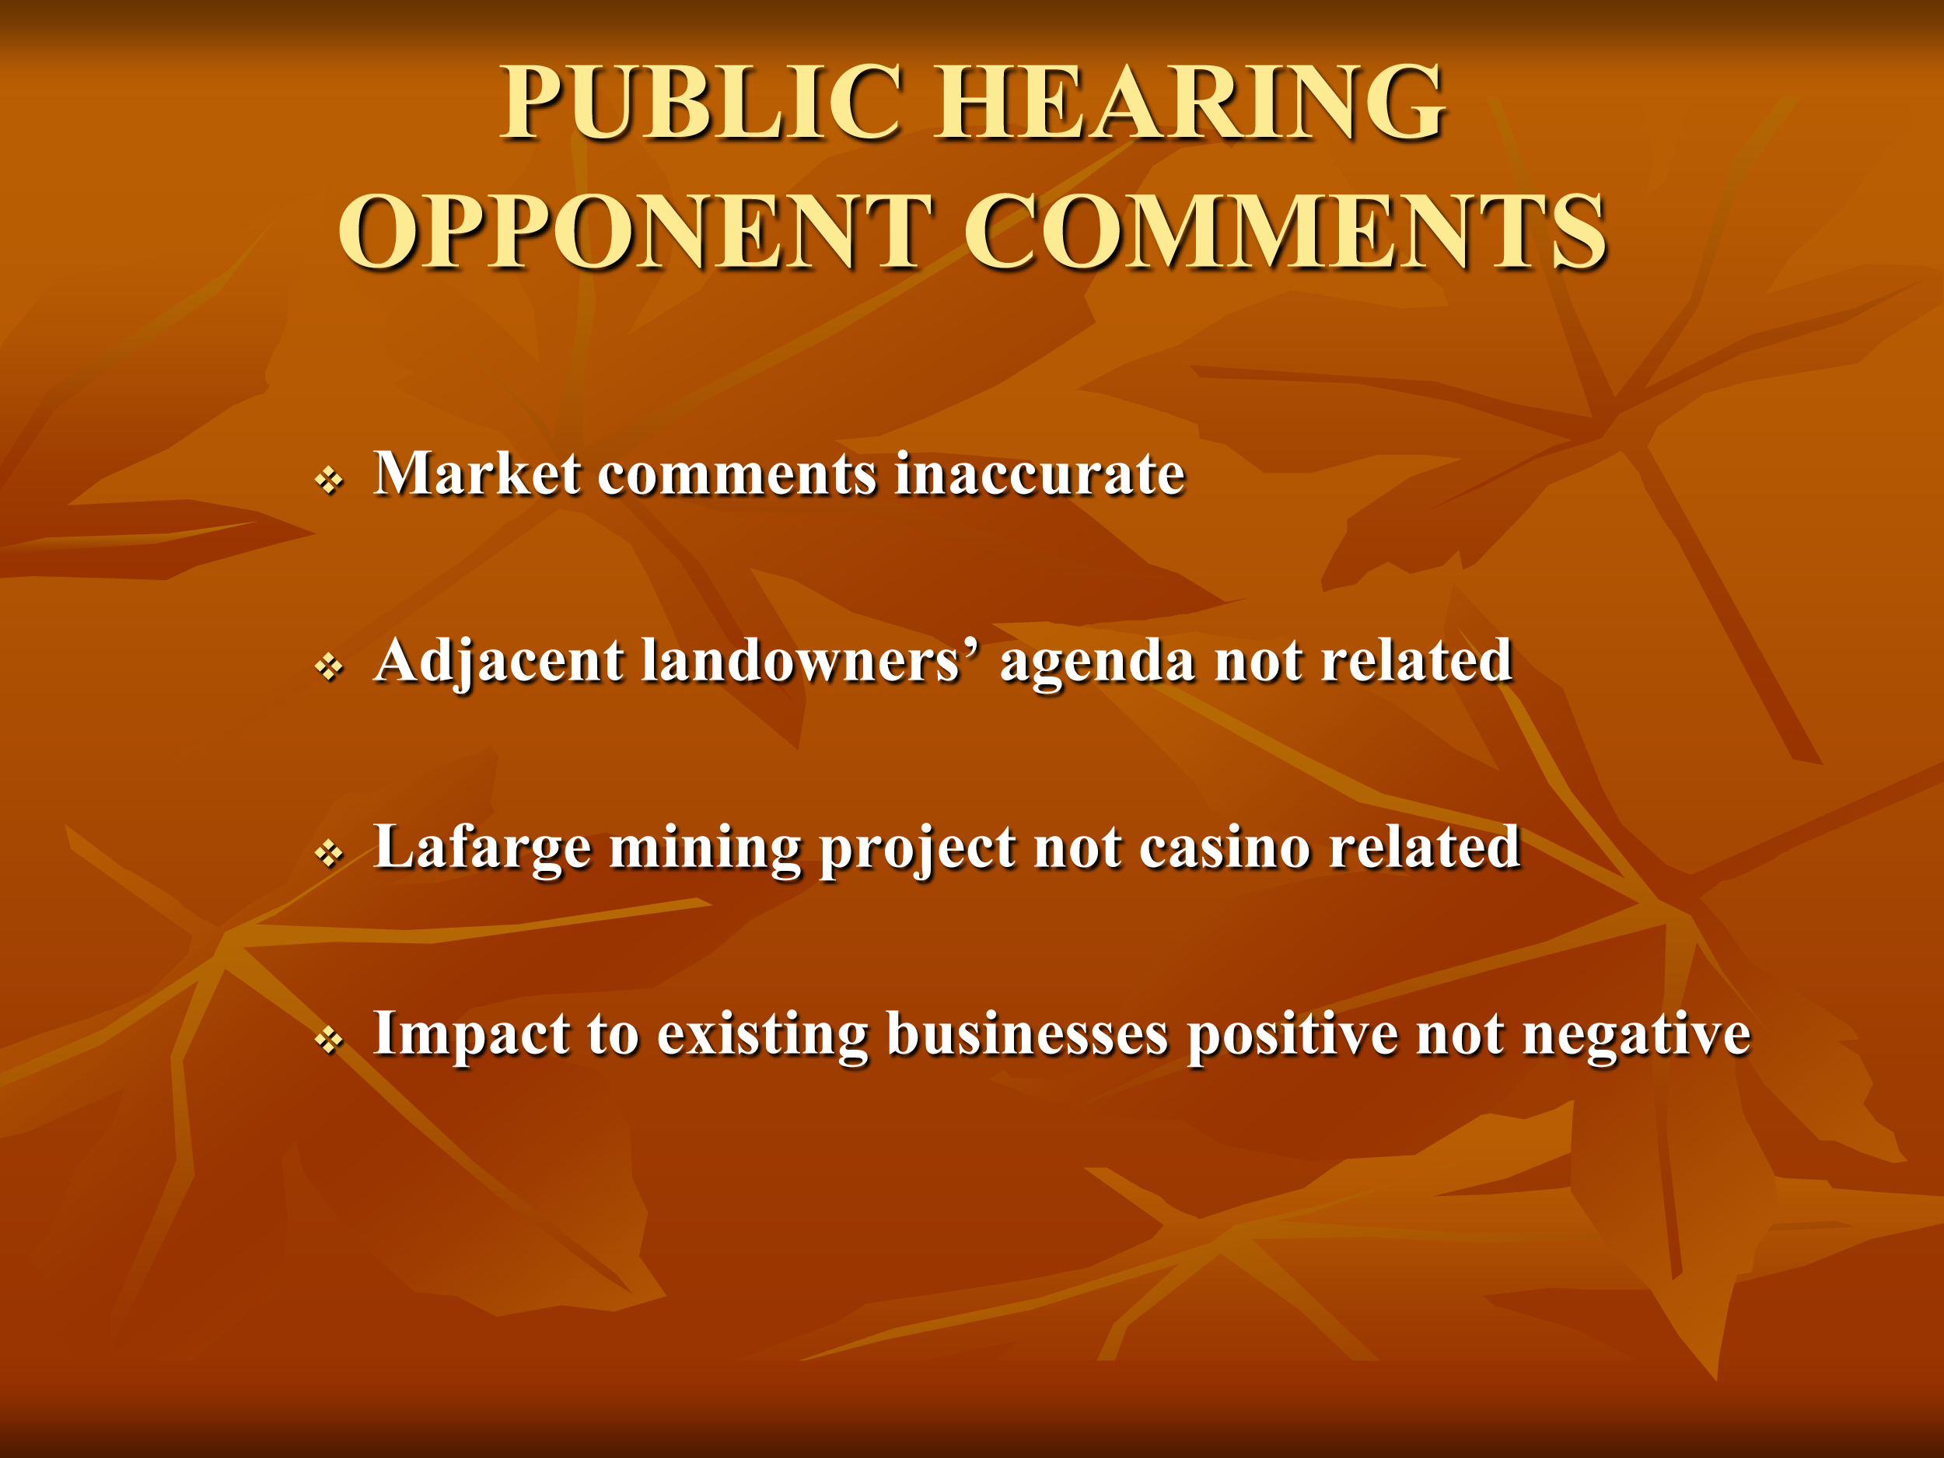

Slide 36
Support Letters

